Slide 1
Personnel Development Program Data Collection System (PDPDCS) Tracie Dickson, OSEP Celia Rosenquist, OSEP Michelle Bloom (AnLar), Program Coordinator Emily Hare (Westat), Program Coordinator Support
November 21, 2024

Slide 2
Welcome New Grantees!
What do you think of when you hear “PDP grant” or “PDPDCS”?

Slide 3
Purpose of the Training
Orient new grantees to data reporting requirements
Improve the quality of data submitted by grantees and scholars
Introduce the PDP Data Collection System (PDPDCS)

Slide 4
Training Agenda
325D, 325H, 325M, and 325R grant priorities and requirements
Grantee reporting and evaluation
Using the PDPDCS
Data entry and collection requirements
Service obligation requirements
Strategies for avoiding security incidents
Resources and support

Slide 5
PDPDCS Data Submission Process
OSEP awards grant
Grantee recruits and selects scholars
Grantee assures that scholars meet regulatory requirements before receiving federal funds
Grantee provides scholarship assistance and grantee/scholar complete Pre-Scholarship Agreement
Grantee submits and updates scholar data
Scholar fulfills obligation through service
Scholar exits program and grantee/scholar complete Exit Certification
Scholar elects cash repayment or is not in compliance
Scholar submits employment
Scholar referred for cash repayment
Employer verifies employment
5

Slide 6
Grant Priorities and Requirements

Slide 7

325D FY 2023 Priority (for 2024)
Preparation of Special Education, Early Intervention, and Related Services Leadership Personnel
Ph.D. or Ed.D. program to increased qualified personnel in leadership and research positions
Prepares graduates for:
Leadership positions as researchers
Special education/early intervention/ related services personnel preparers in IHEs
Leaders in SEAs, LAs, LEAs, or EIS programs

Slide 8

325H FY 2024 Priority
Doctoral Training Consortia Associated with High-Intensity Needs
Ph.D. or Ed.D. program to increased qualified personnel in leadership and research positions
Consortia across multiple IHEs
Prepares graduates for leadership positions

Slide 9
325M FY 2024 Priority
Personnel Preparation of Special Education, Early Intervention, and Related Services Personnel at HBCUs, TCCUs, and other MSIs
Bachelor's degree, certification, master's degree, educational specialist degree, or clinical doctoral degree
Includes scholars preparing for dual certification

Slide 10
325R FY 2024 Priority
Preparation of Related Services Personnel Serving Children with Disabilities who have High-Intensity Needs
Bachelor's degree, certification, master's degree, educational specialist degree, or clinical doctoral degree program
Includes scholars preparing for dual certification or from two or more related services degree programs

Slide 11

325M and 325R Programs
Prepares scholars for professional practice in school settings, distance learning, and natural environments
May include other non-OSEP-funded students in project

Slide 12

Scholar Support and Service Obligation
Consistent with 34 CFR 304.30, each scholar must
Receive support for no less than one academic year, and
Be eligible to fulfill service obligation requirements following degree program completion. Funding across degree programs may be applied differently.

Slide 13

Scholar Funding
Funding does not need to be uniform for all enrolled scholars, but may include:
Tuition and fees
IHE student health insurance
Books, materials, and supplies
Misc. personal expenses
Dependent or childcare
Room and board
Travel and conference registration
Stipends to support scholars’ completion

Slide 14
Scholar Funding Continued
Do not require scholars to work (e.g., as graduate assistants) as a condition of receiving support

Slide 15

Scholar Recruitment
Recruit and enroll scholars within the first 12 months of the project
Demonstrate that scholars enrolled after first 12 months will be able to complete on time
Focus outreach on traditionally underrepresented applicants
Prior approval from OSEP project officer required before admitting additional scholars beyond initially proposed number
Submit a revised project budget if unable to recruit proposed number of scholars

Slide 16
Grantee Reporting and Evaluation

Slide 17
PDP Performance Measures Purpose
Helps measure whether the PDP is meeting its objectives
Demonstrates program progress and effectiveness over time
Used by Congress to determine future program funding
Required under the Government Performance and Results Act (GPRA)

Slide 18

PDP Government Performance and Results Act (GPRA) Measures
Sources of Data:
Grantee enters data in PDPDCS for each scholar receiving support on grant at -
Enrollment,
Annually during enrollment, and
Exit (e.g., complete degree program)
Scholar enters employment information
Employer(s) verify employment

Slide 19

PDP PROGRAM Performance Measure 1
The percentage of preparation programs that incorporate evidence-based practices into their curricula.
Source of data: Expert panel review of syllabi from PDP grantees conducted one year following the grant award.
Syllabi from FY 2024 grants will be reviewed & results reported in FY 2025
Syllabi submitted in application AND new or revised syllabi submitted to OSEP will be used
More information will follow in Year 1

Slide 20
Evidence-Based Practice Areas
325M and 325R:
Assessment,
Behavior (social, emotional, behavioral learning),
Instructional practices,
Instructional strategies, and
Literacy, especially considering the unique needs of children of color with disabilities or multilingual children
325D and 325H:
Research methods,
Evaluation methods, or
Data analysis courses required by the degree program.

Slide 21

PDP PROGRAM Performance Measure 2
The percentage of scholars completing preparation programs who are knowledgeable and skilled in evidence-based practices (EBPs) for children with disabilities.
Source of Data: Grantees report scholar’s exit/completion status and their chosen measure(s).
Grantees must include at least one measure to demonstrate each scholar is “knowledgeable and skilled in use of EBPs” for children with disabilities.

Slide 22
PDP GPRA Performance Measure 2 - continued
Examples of Measures of Knowledge and Skills
ACCEPTABLE Measures | UNACCEPTABLE Measures
Grantee-specific tests (e.g., portfolio, comprehensive exam, dissertation defense) PRAXIS II National organization tests State-specific tests Capstone project or exam required of scholars prior to degree program or grant project completion | Entrance exams (e.g., PRAXIS I, GRE, SAT) University preliminary exams Individual course exams or grades

Slide 23
PDP PROGRAM Performance Measure 3
The percentage of scholars who exit preparation program prior to completion due to poor academic performance.
Source of data: Grantees report scholar’s exit/completion status and reason for exiting prior to completion, if applicable.

Slide 24

PDP PROGRAM Performance Measure 4
The percentage of scholars completing preparation programs who are working in the area(s) for which they were prepared upon program completion.
Sources of data:
Grantees report scholar’s training area and exit/ completion status.
Scholars and employers report scholar’s employment area after exit.

Slide 25

PDP PROGRAM Performance Measure 5
The Federal cost per scholar who completed the preparation program.
Sources of data:
ED G5 database provides financial data for each grant
Grantees report in PDPDCS whether scholars funded exited the training program through completion

Slide 26

PDP PROGRAM Performance Measure 6
The percentage of scholars who completed the preparation program and are employed in high-need districts.
Sources of data:
Completed scholars and their employers who have verified their employment
CCD and School Universe surveys determine if a district is labeled as high-need

Slide 27
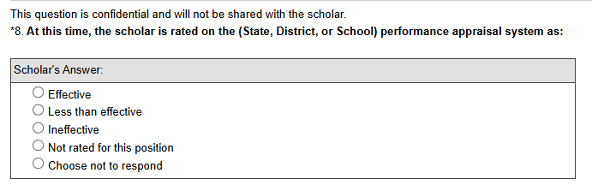
PDP PROGRAM Performance Measure 7
The percentage of scholars who completed the preparation program and are rated effective by their employers.
Sources of data:
Scholars who completed their program and submitted an employment record
Employers rating the scholar’s effectiveness in the verification form

Slide 28

PDP PROGRAM Pilot Outcome Measure
The percentage of scholars who completed the preparation program and are employed in the field of special education for at least two years.
Sources of data:
Grantees report scholar’s exit/completion status
Scholars and employers report scholar’s employment area after exit

Slide 29
Grant Performance Reports: APR
Annual Performance Reports (APR)
OSEP will send instructions for preparing and submitting APRs to grantees prior to February 1 annually
APR Resources
Deadline for submitting is COB on the first Friday in May (4:30 pm ET)
Submitted in G5/G6 (https://g6.ed.gov/)

Slide 30
Grant Performance Reports: FPR
Final Performance Report
OSEP instructions will clarify which portions require updates, summaries of the full award period, and/or new information
Due no later than 90 days after end of project award period
Submitted in G5/G6

Slide 31
2024 Project Evaluation
325D, 325H, 325M, and 325R:
Evaluate how well the goals or objectives of the proposed project have been met
Collect and analyze data on OSEP-supported scholars [325M only: disaggregated by race, national origin, primary language(s), and disability status]

Slide 32
Using the PDPDCS

Slide 33
Secondary Users
Project Directors are responsible for all data entries; however, secondary users are permitted to assist in the process.
Secondary users:
Can enter scholar information, and
Have a unique log in.
Only three people per grant may access.
Project Directors may change the secondary user(s) at any time.
Note: You may NOT create a shared inbox for your secondary user(s) – each user requires a unique login.

Slide 34
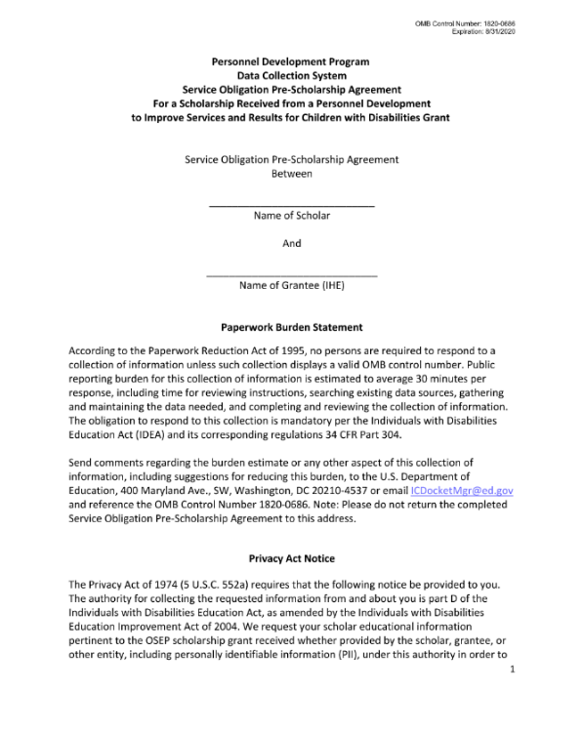
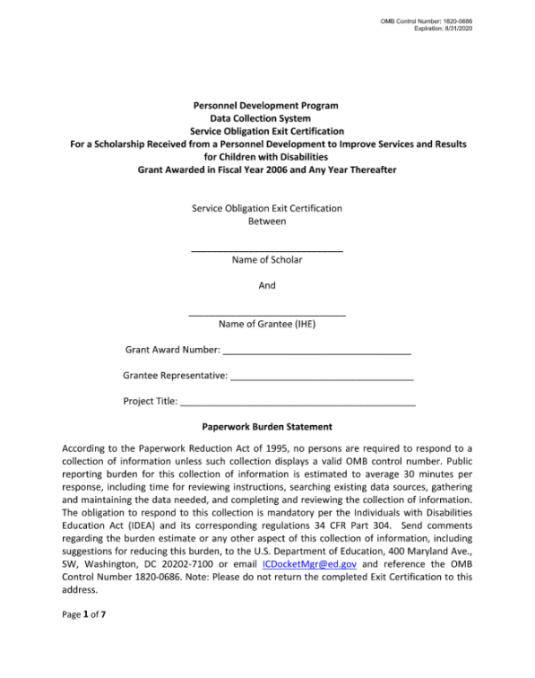
PDPDCS Forms
Grantees and scholars must sign an OMB-approved Pre-Scholarship Agreement and Exit Certification for each funded scholar.
Grantees may be held responsible for funds provided to scholars with missing or invalid documents.
Grantees must retain all grant records until each scholar’s service obligation has been fulfilled or paid back.

Slide 35

Issues with PSAs (and ECs)
Missing or invalid project director signature
Missing or invalid scholar signature
Missing grant information
Missing pages
Uploaded to incorrect scholar record

Slide 36
PDPDCS: Live Demonstration
PDPDCS demonstration will show:
Logging into the system
Updating grant and contact information
Adding a secondary user
Using the digital Pre-Scholarship Agreement (PSA) and entering scholar data
Updating scholar data
Tracking scholar’s service obligation fulfillment
Using the digital Exit Certification (EC) to exit a scholar

Slide 37
Data Entry and Collection Requirements

Slide 38

Timeline for Enrolling Scholars
Enter and submit scholar contact and enrollment information within 30 days of scholar enrollment in degree program.
The scholar must have:
Registered for classes
Received “scholar support” from grant project
Signed PSA

Slide 39

Submitting Scholar Records
Once a scholar record is submitted by the grantee, scholars will access the PDPDCS to:
Confirm contact information;
Review training information;
View service obligation status; and
Enter eligible employment information to fulfill their service obligation.

Slide 40
Pending Scholars
OSEP requires that scholars are in a pending status for no more than 30 days.
Help Desk staff will contact you and your Project Officer if your grant has scholars in a pending status at the end of each annual data collection period.

Slide 41
Timeline for Updating and Exiting Scholars
Update scholar contact and program completion information within 30 days of:
Scholar status changes
Scholar completing one academic year of program
Grant budget period ending

Slide 42
Exiting Scholars
Step 1: Ensure all information in Sections A – I is accurate
Step 2: Complete digital EC or upload PDF EC
Step 3: Enter scholar exit information (Sect. J) if applicable
Step 4: Save and Submit scholar record

Slide 43

Exit All Scholars BEFORE Your Grant Ends
Any scholar who has not graduated/ completed or previously exited when a grant closes will be assigned the status of “exited without completion”
Project Directors are responsible for obtaining Exit Certifications from these scholars too. Service obligation requirements still apply.

Slide 44
PDPDCS Reporting: Timely Submission
Submit all data on time (APR, PDPDCS, and FPR).
According to 34 CFR 75.253(a)(3), the timely submission of this report is one of the factors that the Secretary will consider in determining whether to continue your project's funding for next fiscal year.
According to section 75.217(d)(3)(ii), the Secretary can consider the failure to submit scholar data in a timely fashion in determining your project’s ability to obtain future grants from the Office of Special Education Programs or under any other Department program.

Slide 45
Please Exit Your Scholars!
Review and complete entire scholar record prior to changing scholar status
Ensure your scholars SIGN THEIR EXIT CERTIFICATION
Provide all documents and grant information to any staff superseding you

Slide 46
Non-Response Processes
Alert grantee to data quality issue(s)
Contact any affected scholars
Contact IHE Department Head and/or Certifying Rep
Work with IHE to work out a monetary repayment plan
Discuss issue(s) with OSEP PO and grantee

Slide 47
Fulfilling Service Obligation

Slide 48
Service Obligation Requirements
Requirements for employment to be deemed eligible:
Paid position, not funded by an OSEP grant program
Cannot be part of an internship, practicum, or other work-related requirement of the scholar’s completion of the preparation program

Slide 49
Service Obligation Requirements – continued
Direct Service:
At least 51% of the infants, toddlers, and children to whom the individual provides services are receiving special education, related services, or early intervention services from the individual; or
The individual spends at least 51% of their time providing special education, related services, or early intervention services to infants, toddlers, and children with disabilities.
Indirect Service:
If the position involves supervision including in the capacity of a principal, teaching at the postsecondary level, research, policy, technical assistance, program development, or administration, the individual spends at least 51% of their time performing work related to the scholarship training.

Slide 50

Scholars’ Employment Record
Information collected includes:
Contact information;
Type of organization;
Dates of employment;
Type of employment;
Full or part time position;
Training area(s);
Whether the position meets PDPDCS time requirements; and
Certification or licensure.

Slide 51
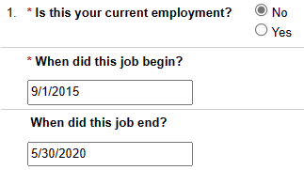
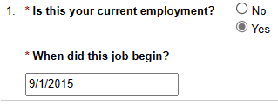
Service Obligation Calculator
Previous Employment
Current Employment

Slide 52

Employer Submission Requirements
Employers verify employment information within the PDPDCS
Scholars do not receive credit for service obligation until the employer has verified their employment
Scholars receive an email when their employment is verified or disputed

Slide 53
Scholar Reporting Requirements
Recommend to your scholars to review the resources available on the Training Page: https://pdp.ed.gov/OSEP/Home/Training
Notify scholars at the beginning of the program that they will be required to provide licensure test results to you.
Arrange and conduct exit interviews with each exiting scholar.

Slide 54
Avoiding Security Incidents

Slide 55

Security Incidents
A security incident occurs if personally identifiable information (PII) is potentially viewable to unrelated parties.
Examples from PDPDCS:
Uploading an unredacted Pre-Scholarship Agreement (PSA) PDF to the wrong scholar record
Sending unencrypted documents (Social Security Card, Driver’s License, etc.) in an email to the PDPDCS Help Desk

Slide 56
Impacts of Security Incidents on Department Staff
PDPDCS staff must notify the Department’s Education Security Operation Center (EDSOC), document the incident, and expunge the file or email from the servers
Additional interviews, investigations, and mitigation strategies may be necessary
PDPDCS Staff must review all other scholar records and documentation associated with the grantee

Slide 57
Impacts of Security Incidents on Grantees
Grantees must resubmit scholar documentation, complete security incident report, and participate in investigation interviews as needed.
Project Directors and Secondary Users will be required to participate in a security training to understand the proper handling of scholar PII and the consequences of data breaches.
The grant will be placed on a security incident list tracked by PDPDCS and OSEP staff. If further incidents occur, the grant and university could be placed on high-risk status, impacting their ability to receive future federal funding.

Slide 58
How to Avoid Security Incidents
Always encrypt files being sent by email, including to the PDPDCS Help Desk.
Use the digital Pre-Scholarship Agreements and Exit Certifications to avoid uploading a document to the wrong scholar record.
Implement a file naming convention to track files associated with each scholar’s record: PSA_J_DOE.pdf.

Slide 59
Resources and Support

Slide 60

Always Read System Emails
Notifications regarding system or policy changes as well as data submission reminders are sent via email.
Please add serviceobligation@ed.gov to your contact list.
Check your email settings to be sure emails from this account are not marked as spam.

Slide 61

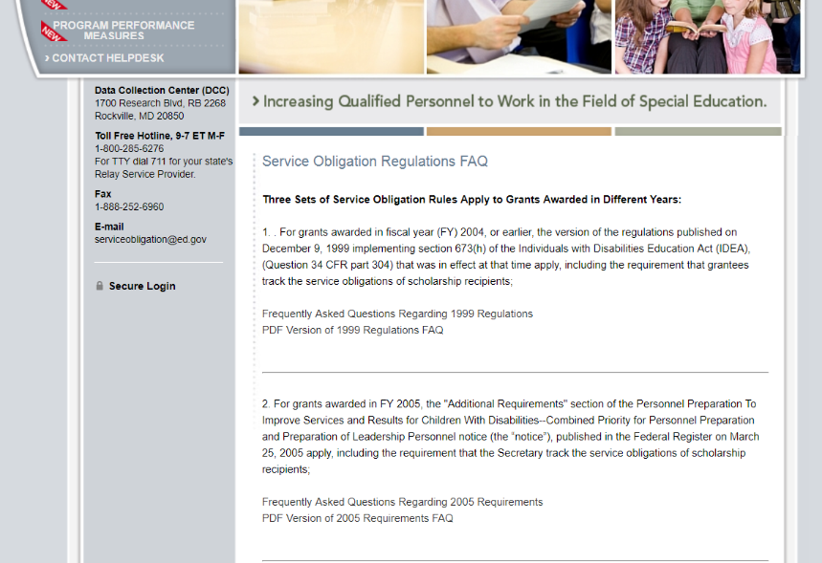
Support Using PDPDCS: Website Resources
PDPDCS resources include:
A closed-captioned recording of this webinar will be made available (https://pdp.ed.gov/OSEP/Home/Training).
PDPDCS Frequently Asked Questions (https://pdp.ed.gov/ OSEP/Home/dcsfaq).

Slide 62
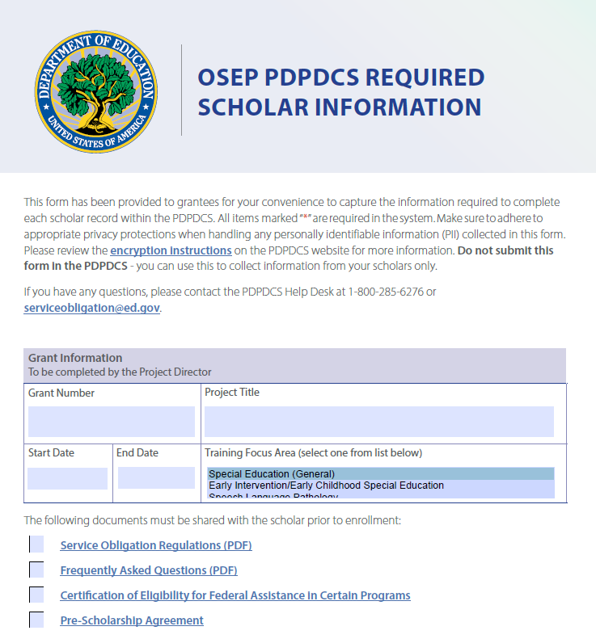
Required Scholar Information
Reference document to assist grantees with collecting information from scholars
Not to be submitted into PDPDCS
Adhere to privacy protections

Slide 63
Support Using PDPDCS: Help Desk
The PDPDCS Help Desk is available by phone or email to answer questions you or your scholars may have regarding the PDPDCS. Help Desk support is available:
Monday through Friday from 8 am to 8 pm, ET.
Email: serviceobligation@ed.gov.
Toll Free Hotline: 1-800-285-6276.
If someone is not available when you call, please leave a message. A Help Desk operator will return your message within one business day.
A designated specialist can also spend additional time walking you through components of the PDPDCS. Just contact the Help Desk to set up an appointment.

Slide 64
Questions and Discussion
We want your feedback! Please respond to the Teams poll or SurveyMonkey poll.
More questions?
PDPDCS Help Desk
Support available from 8 am to 8 pm EST
Monday through Friday
1-800-285-6276
serviceobligation@ed.gov

